Slide 1
Chapter 7 Thinking and intelligence

Slide 2
Classifying intelligence: Charles Spearman
Intelligence consisted of one general factor, called g.
Focused on the commonalities among various intellectual abilities.

Slide 3
Classifying intelligence: Raymond Cattell
Crystallized intelligence: acquired knowledge and ability to retrieve it; helps you solve concrete and straightforward problems.
Fluid intelligence: the ability to see complex relationships and solve problems; helps you solve abstract and complex problems.

Slide 4
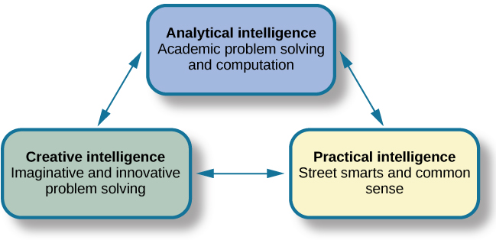
Classifying intelligence: Robert Sternberg’s Triarchic Theory of Intelligence
Practical intelligence: “street smarts”
Analytical intelligence: an ability to analyze, evaluate, judge, compare, and contrast.
Creative intelligence: inventing or imagining a solution to a problem.

Slide 5
Classifying intelligence: Howard Gardner’s Multiple Intelligence Theory
Linguistic, logical-mathematical, musical, bodily kinesthetic, spatial, interpersonal, intrapersonal, & naturalistic intelligence
A person excels in some and falters in others.
Emotional intelligence: the ability to understand emotions, show empathy, understand social relationships, regulate emotion, etc.

Slide 6
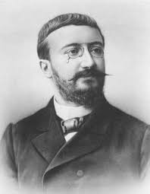
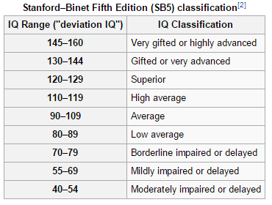
Measures of intelligence: Binet
Alfred Binet: an intelligence test to determine which children might have difficulty in school
Louis Terman: standardized and normed Binet’s test in America, known as Stanford-Binet Intelligent Test

Slide 7
Measuring intelligence: David Wechsler
Believed that intelligence encompassed “the global capacity of a person to act purposefully, to think rationally, and to deal effectively with this environment”
Wechsler Adult Intelligence Scale (WAIS-V), Wechsler Intelligence Scale for Children (WISC-V), Wechsler Preschool and Primary Scale of Intelligence (WPPSI-III)
Flynn Effect

Slide 8

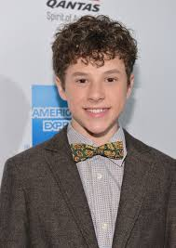
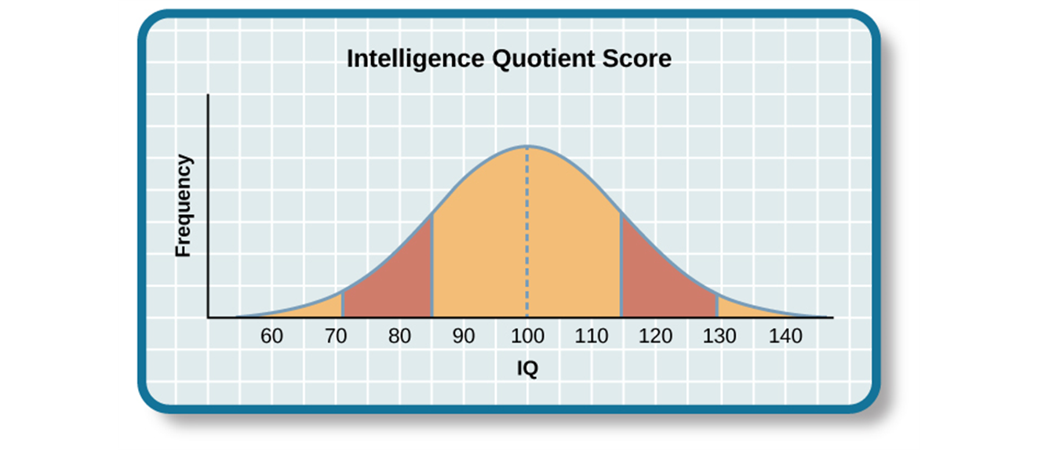
The Bell Curve
Average: 100
Standard deviation: 15
82% of the population: 85-115
2.2% of the population: below 70, significant cognitive delays

Slide 9
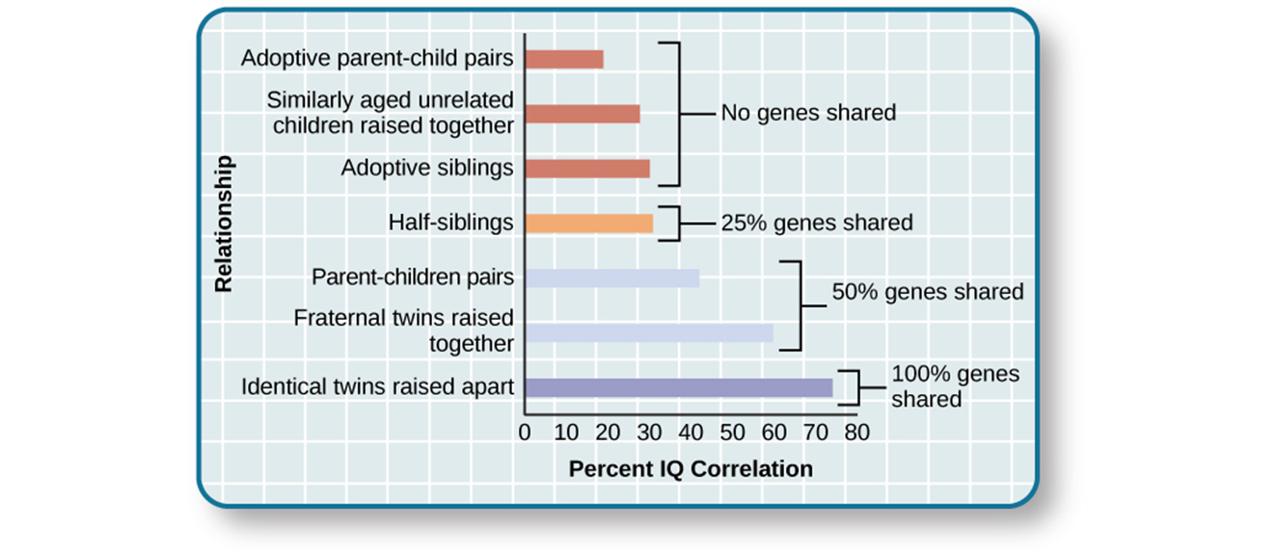
Source of intelligence: nature or nurture
Minnesota Study of Twins Reared Apart: revealed a genetic component of intelligence
Environment also plays a role

Slide 10
Source of intelligence: nature or nurture
Range of reaction: Each person responds to the environment in a unique way based on his or her genetic makeup.
Whether you reach your genetic intellectual potential is dependent on the environmental stimulation
Science’s taboo: racial differences in IQ

